Slide 1
Brief History of Java
1
Java was originally called “Oak”
Java was meant to be a programming language specifically for appliances and various small devices
The original specification:
Targeted set-top boxes for cable television that allowed users a control and interactivity when using the service
Java specification is owned by Sun Microsystems.
The newly emerging Internet proved to be a much better platform for the specification:
The way the Net was being used had the same interactivity they planned for cable television customers

Slide 2
The Java Programming Language
2
The Java programming language is a fully object-oriented language.
The standard edition provides pre-built libraries and APIs that provide useful capabilities out of the box.
Java is portable. The Java language and libraries are platform-independent.
Java is multi-threaded. Java has a sophisticated set of synchronization primitives that are based on the widely used monitor and condition variable paradigm.
Java is robust. Programmers don't have to worry about freeing or corrupting memory.

Slide 3
The Java Technology Platform
3
Java applications run on a virtual machine environment that:
Isolates the underlying platform
Achieves portability and performance
Provides security
Java source code is written as plain text files (.java) that are compiled as platform independent byte-codes (.class)
Java byte-codes are interpreted and executed by the virtual machine that passes the instructions to the actual platform

Slide 4

The Java Technology Platform
Java Byte-Code
(.class)
JVM
(Win32)
Java Source File
(.java)
Java Byte-Code
(.class)
Java Compiler
JVM
(Solaris)
Java Byte-Code
(.class)
JVM
(Mac OS)
4
Notes:
Explain that Java is an entire platform, not just a programming language. This slide summarizes all the important aspects and features commonly associated with the term ‘Java’
The virtual machine provides a standardized environment for byte-codes to execute. By isolating and hiding the underlying hardware platform, Java programmers will not have worry about the specifics of their target platform when writing code. All compliant virtual machines are capable of reading byte-codes. Byte codes can be executed from one VM to another without a need to re-compile
Some java-enabled web browsers have their own JVM separate from the one used by the platform

Slide 5
Java Development Kit
5
Java Development Kit (JDK):
Is a set of software, tools and libraries that need to be installed in order to start writing and compiling Java applications
Installs the virtual machine (runtime environment) needed in order to execute Java applications on the platform
The virtual machine can be downloaded separately from the JDK as a JRE (Java Runtime Environment) download

Slide 6
Installing the JDK
The License Agreement of the JDK used in this course is found in the Appendix section of this module.
If the installer isn’t locally available, go to http://java.sun.com and download the J2SE6 installer
Make sure to download the appropriate ‘JDK’ version for your platform
Once the installer is available, execute the installer and follow the prompted procedures.
Just choose the default choices for any installation options
6
Notes:
JDK license details can be found in the Appendix section of this module.
For the remainder of the course, JavaSE6 and the Eclipse IDE software will be used
In Windows, by default it should go to C:\Program Files\Java\jdk1.6.0_04\ and C:\Program Files\Java\jre1.6.0_04 (the version numbers might change depending on what was downloaded)

Slide 7
Integrated Development Environment
7
Java source files are in text format and can be written using any text editor
For greater productivity, download and install an Integrated Development Environment (IDE). An IDE:
Provide you with a set of tools that assist in developing, testing, and debugging Java applications
Popular IDEs are :
NetBeans (from http://java.sun.com)
Eclipse (http://eclipse.org)

Slide 8
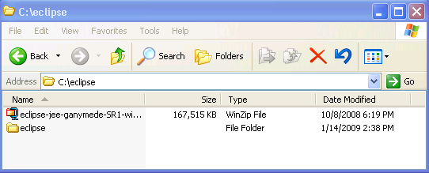
Installing and Configuring Eclipse
8
http://www.eclipse.org/ and download the Eclipse IDE.
The installer should be an archive file.
Extract the files in the archive to a directory of your choice (c:\eclipse in the example below).

Slide 9
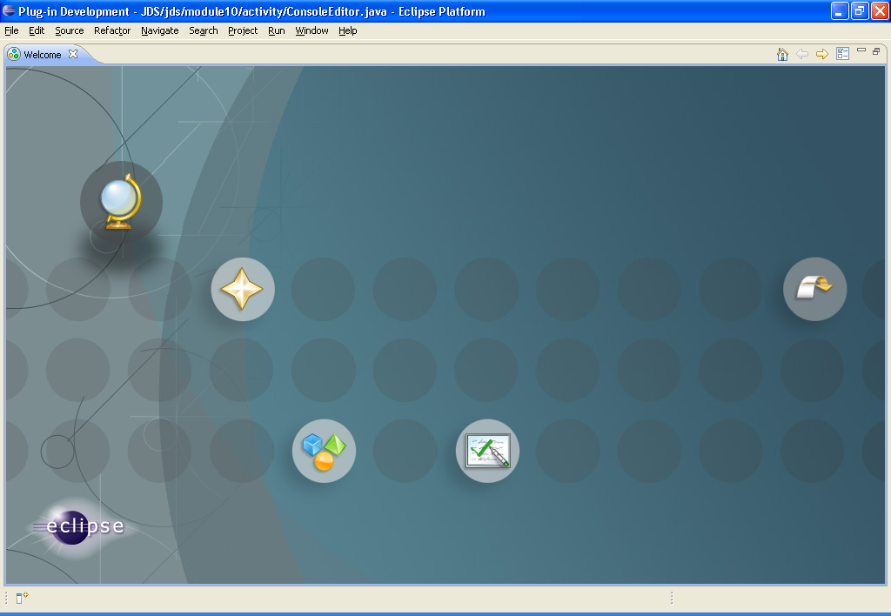
Installing and Configuring Eclipse
If it is your first time using eclipse, the ‘Welcome’ window should give you some first-timer options and tutorials.
Close the window for now. This can be accessed any time under the ‘Help->Welcome’ menu
9

Slide 10
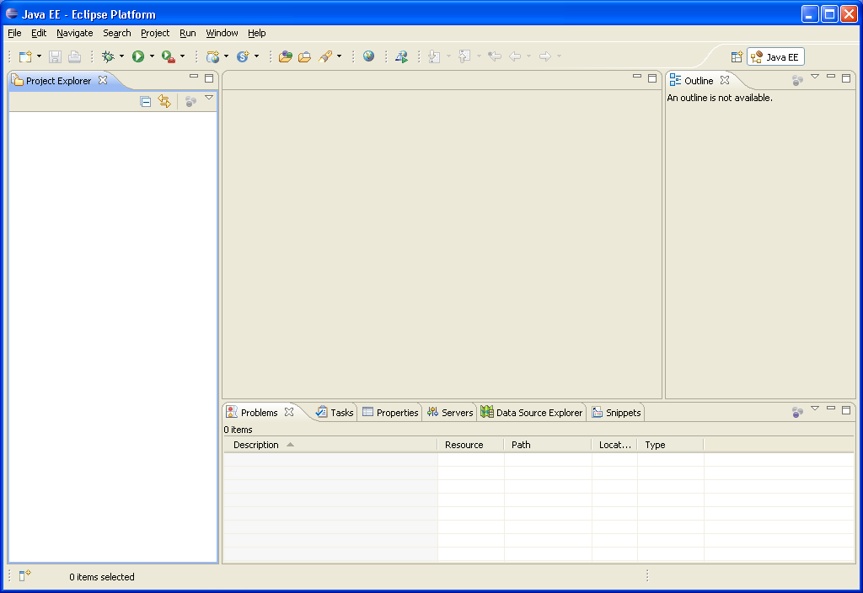
Installing and Configuring Eclipse
The editor window is where the selected component can be viewed and edited
The Project explorer allows you to browse the contents of the various projects you have created under the workspace
Information tabs at the bottom provide additional information about the application/component selected
The outline view allows you to look at the various elements of a component selected from the project explorer
10

Slide 11
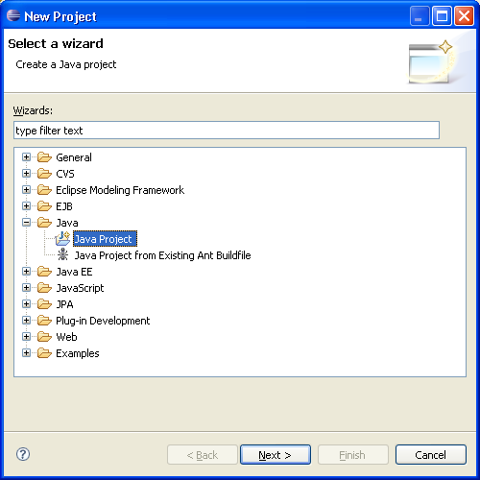
Installing and Configuring Eclipse
Create a new project by selecting File->New->Project
In the wizard, select Java Project
11
Notes:
The kind of project chosen will dictate what kind of environment the workbench will configure itself to have. Since we’re only dealing with core Java applications, a basic Java Project will suffice

Slide 12
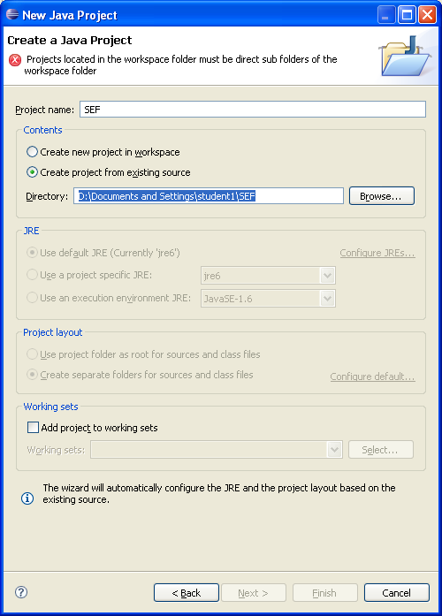
Installing and Configuring Eclipse
Use ‘JavaTraining’ as the project name
Select ‘Create Project from an existing source’ and browse to the directory named SEF under the directory where the Eclipse SEF Participants Workspace archive is extracted
Click ‘Finish’ as we don’t need the other steps
12

Slide 13
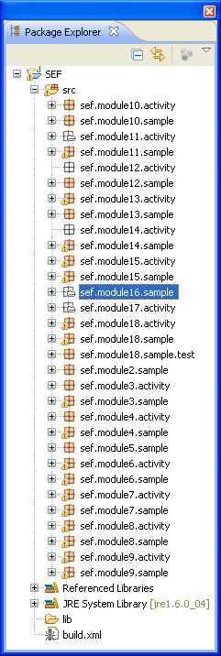
Installing and Configuring Eclipse
The work files for this training is divided into packages for each module
In the package explorer, go to sef.module2.sample and double click the file ‘HelloWorld.java’
The main editor view should show the contents of the HelloWorld.java file and the outline view should show the different elements of that file
13

Slide 14
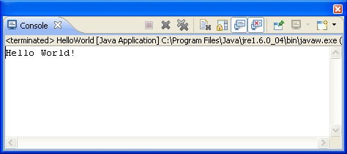
Installing and Configuring Eclipse
The HelloWorld file is a Java executable
Execute the file by right clicking the file->Run As->Java application
The console tab below the main editor should show the results of the application
14

Slide 15
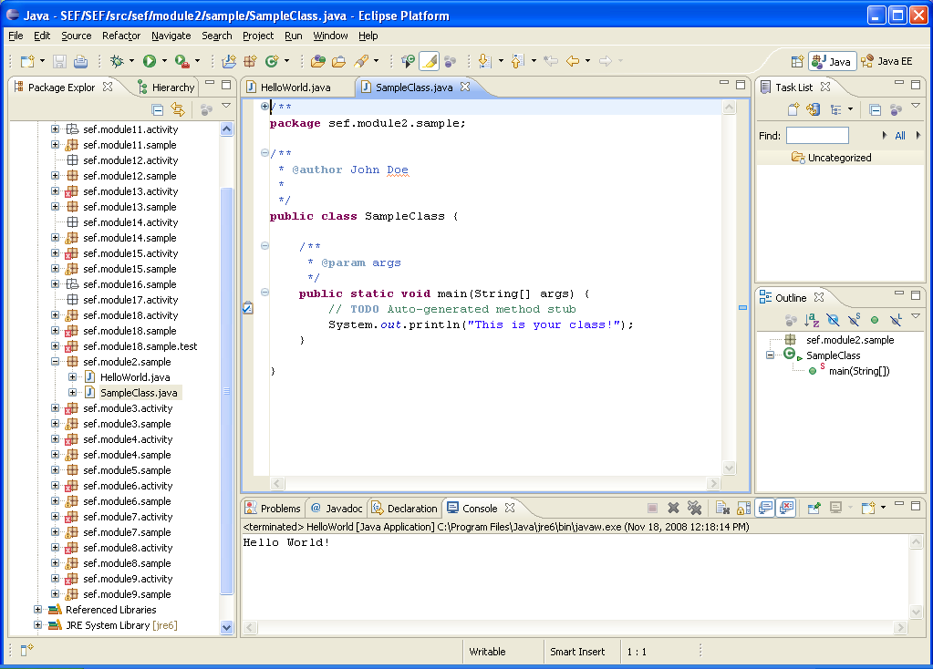
Create a new Java Class
Right-click on the package sef.module2.sample and select New->Class
Give the class a name ‘SampleClass’
Add ‘public static void main(String arg[]) in the method stubs
Click ‘Generate Comments’
Click Finish when done
15

Slide 16
Create a new Java Class
16
Complete the main method by typing:
public static void main(String[] args) {
// TODO Auto-generated method stub
System.out.println("This is your class!");
}
Compile and execute the new class and view the results!

Slide 17
Java Source File Structure
17
Java applications are composed of text files ending with a ‘.java’ suffix that contain source codes
Each Java source file consists of a ‘class declaration’, which follows a specific structure
Java source files are compiled into ‘.class’ files which are then run by the Java interpreter

Slide 18
Java Source File Structure
declaration order
1. Package declaration
Used to organize a collection of related classes.
2. Import statement
Used to reference classes and declared in other packages.
3. Class declaration
A Java source file can have several classes but only one public class is allowed.
/*
* Created on Jan 12, 2015
*
* First Java Program
*/
package app.module.sample;
import java.lang.*;
/**
* @author Pradeep
*/
public class MainSample{
public static void main(String[] args) {
// print a message
System.out.println("Welcome to Java!");
}
}
18

Slide 19
Java Source File Structure
The name package implies a collection of classes, somewhat like a library.
Import statements must come after any package statements and before any code.
Import statements cannot come within classes, after classes are declared, or anywhere else.
The import statement allows you to use a class directly instead of fully qualifying it with the full package name.
19

Slide 20
Java Source File Structure
Comments
1. Block Comment
/*
* insert comments here
*/
2. Documentation Comment
/**
* insert documentation
*/
3. Single Line Comment
// insert comments here
The compiler ignores comments.
/*
* Created on Jan 12, 2015
*
* First Java Program
*/
package app.java.sample;
import java.lang.*;
/**
* @author pradeep
*/
public class MainSample{
public static void main(String[] args) {
// print a message
System.out.println("Welcome to Java!");
}
}
Whitespaces
Tabs and spaces are ignored by the compiler. Used to improve readability of code.
20

Slide 21
Java Source File Structure
/*
* Created on Jan 12, 2015
*
* First Java Program
*/
package app.java.sample;
import java.lang.*;
/**
* @author Pradeep
*/
public class MainSample{
public static void main(String[] args) {
// print a message
System.out.println("Welcome to Java!");
}
}
Class
Every Java program includes at least one class definition. The class is the fundamental component of all Java programs.
A class definition contains all the variables and methods that make the program work. This is contained in the class body indicated by the opening and closing braces.
The name of the public class declaration should be the same as the name of the file (case sensitive).
21

Slide 22
Java Source File Structure
Braces
/*
* Created on Jan 12, 2015
*
* First Java Program
*/
package app.java.sample;
import java.lang.*;
/**
* @author Pradeep
*/
public class MainSample{
public static void main(String[] args) {
// print a message
System.out.println("Welcome to Java!");
}
}
Braces are used for grouping statements or block of codes.
The left brace ( { ) indicates the beginning of a class body, which contains any variables and methods the class needs.
The left brace also indicates the beginning of a method body.
For every left brace that opens a class or method you need a corresponding right brace ( } ) to close the class or method.
A right brace always closes its nearest left brace.
22

Slide 23
The ‘main( )’ Method
The ‘main’ method is where the execution of a java application begins
Syntax: public static void main( String[] args ) {
//Main method implementation goes here
}
Classes that have a main method declared inside serve as the starting point of the application.
23
Notes:
Refer to MainSample.java

Slide 24
The ‘main( )’ Method
main() method
This line begins the main() method. This is the line at which the program will begin executing.
/*
* Created on Jan 12, 2015
*
* Hello World Program
*/
package app.java.sample;
/**
* @author pradeep
*/
public class MainSample {
public static void main(String[] args) {
//Prints out 'Hello World!' System.out.println( "Hello World!" );
}
}
String args[]
Declares a parameter named args, which is an array of String. It represents command-line arguments.
Terminating character
Semicolon (;) is the terminating character for any java statement.
24

Slide 25
Expressions and Statements
25
Expressions are symbols that evaluate to some kind of value
Expressions can be a ‘literal’ or a ‘constant’
“hello”
‘a’
12345
Expressions can be the result of an operation
X / Y * Z
Expressions can be the return value of a function or a method call
getFactorial(3)

Slide 26
Expressions and Statements
26
A Statement is a complete unit of instruction, usually ended by a semicolon ( ; )
The example below is a statement assigning the value of the expression to the variable
String greeting = “hello”;
final static double PIE = 3.14
z = x + y;
result = getFactorial(z);
Date today = new Date();
Method calls are also statements
System.out.println(“Hello”);

Slide 27
Java Keywords
27
Java recognizes a set of keywords as part of the Java language
Java keywords are used to support programming constructs, such as class declaration, variable declaration, and control flow

Slide 28
Java Keywords
abstract
default
if
package
synchronized
assert
do
implements
private
this
boolean
double
import
protected
throw
break
else
instanceof
public
throws
byte
extends
int
return
transient
case
false
interface
short
true
catch
final
long
static
try
char
finally
native
void
super
class
float
new
volatile
continue
for
null
switch
while
28

Slide 29
Variables
Syntax: <data type> <identifier_name>;
Examples: int myInteger;
String myFirstName;
Date theDateToday;
29
A named storage location used to represent data that can be changed while the program is running
Declaration specifies a variable's properties like its data type and identifier name
Basic variable declaration in Java:

Slide 30
Variables: Initialization
Syntax: <identifier_name> = <initial_value>;
Example: myInteger = 0;
Syntax: <identifier_name> = <initial_value>;
Examples: myFirstName = “Jason”;
theDateToday = new Date( );
30
Initializing variables with primitive data type:
Initializing variables with reference data type:

Slide 31
Variables: Scope
31
Refers to portions or sections of a program where the variable has value and is said to be ‘visible’
Types of variables by scope:
Class Variables
Instance Variables
Local Variables

Slide 32
Variables: Scope
Local Variable
Declared inside methods and/or subroutines. aString is local to the method main
package test.test1.sample;
public class VariableScope {
/**
* @param args
*/
public static void main(String[] args) {
String aString = “This is a local variable”;
}
}
class Employee {
public static int totalCount = 0;
private String myFirstName;
private String myLastName;
private int myAge;
}
Class Variable
Declared outside methods but inside class. Denoted by static keyword.
Instance Variables
Declared outside methods but inside class.
32

Slide 33
Data Types
33
A data type determines the values that a variable can contain and the operations that can be performed on it
Primitive Data Types
Reference Data Types
A primitive data type represents single, atomic value and is used as the building blocks of more complex types
A reference data type is a more complex type that is used to represent an object

Slide 34
Primitive Data Types
Type | Bits | Lowest Value | Highest Value
boolean | (n/a) | false | true
char | 16 | '\u0000' [0] | '\uffff' [2¹⁶-1]
byte | 8 | -128 [-2⁷] | +127 [2⁷-1]
short | 16 | -32,768 [-2¹⁵] | +32,767 [2¹⁵-1]
int | 32 | -2,147,483,648 [-2³¹] | +2,147,483,647 [2³¹-1]
long | 64 | -9,223,372,036,854,775,808 [-2⁶³] | +9,223,372,036,854,775,807 [2⁶³-1]
float | 32 | ±1.40129846432481707e-45 | ±3.40282346638528860e+38
double | 64 | ±4.94065645841246544e-324 | ±1.79769313486231570e+308
34

Slide 35
Variable Assignment
Syntax: <variable_name> = <the_value>;
Example: myInteger = 0;
35
Refers to the assignment or setting of the value of a variable, which is done by using the assignment operator
The data type of the value being assigned must be compatible with the data type of the variable receiving the value

Slide 36
Data Types
X
42
Day = 25
Month = June
Year = 200
today
36
A primitive data type assigned a value:
int x = 42;
A reference data type assigned a value:
Date today = new Date();

Slide 37
Type Conversion
37
Refers to the conversion of the data type of a value to another data type
Also called ‘type casting’
Implicit casting is done by the compiler automatically in certain cases to ensure that the program runs correctly
Explicit casting is done when the program declares that the data type of an expression is to be modified

Slide 38
Primitive Casting Flow
widening conversion
char
byte
short
int
long
float
double
narrowing conversion
38

Slide 39
Implicit Casting
Example A: int a = 1;
double b = a;
Example B: float x = 1.0;
double y = x;
39
Implicit casting is an implied casting operation
Since a double is ‘wider’ than either an integer or a floating point, it is able to accept and cast their values implicitly
Notes:
Implicit casting usually takes place when casting from a narrower data type to a broader data type, this can also be referred to as widening conversion.

Slide 40
Explicit Casting
Syntax: <destination variable> = (<destination data type>) <source variable>
Example A: double a = 1.5;
int b;
b = ( int ) a
40
Explicit casting is a required casting operation
Because an integer is ‘narrower’ than the double being assigned, it has to be explicitly stated that the assignment is intentional
A narrowing conversion will sometimes lose a part of the original value during conversion

Slide 41
Reference Casting
41
Refers to the conversion of a reference data type (an object) to another reference data type
Upcasting/Downcasting refers to conversion up and down the inheritance hierarchy

Slide 42
Java Operators
<operand 1> + <operand 2> Addition
<operand 1> - <operand 2> Subtraction
<operand 1> / <operand 2> Division
<operand 1> * <operand 2> Multiplication
<operand 1> % <operand 2> Modulo
Examples:
1 + 1
A * (Z + 1)
42
Arithmetic operators are used to perform mathematical operations on numeric values

Slide 43
Java Operators
<variable> = <expression>;
Examples:
name = “John Doe”;
age = 23;
Date today = new Date();
43
Assignment operators are used to assign values to variables
The following are unary operators
prefix
Y = ++x; Add 1 to x before being assigned to y
Y = --x; Subtract 1 from x before being assigned to y
postfix:
Y = x++; Assign x to y before adding 1
Y = x--; Assign x to y before subtracting 1

Slide 44
Java Operators
Relational operators are used to perform comparisons
They always evaluate to either a true or false (boolean expression)
<Expression 1> < <Expression 2> Expression 1 is less than Expression 2
<Expression 1 > > <Expression 2> Expression 1 is greater than Expression 2
<Expression 1 > <= <Expression 2> Expression 1 is less than or equal to Expression 2
<Expression 1 > >= <Expression 2> Expression 1 is greater than or equal to Expression 2
<Expression 1> != <Expression 2> Expression 1 is not equal to Expression 2
Example:
boolean test = x < y;
44

Slide 45
Java Operators
45
Logical operators are used to evaluate boolean expressions
<Expression 1> & <Expression 2> AND
<Expression 1 > | <Expression 2> OR
<Expression 1 > ! = <Expression 2> NOT
<Expression 1 > ^ = <Expression 2> XOR
<Expression 1> && = <Expression 2> Short-circuited AND
<Expression 1> || = <Expression 2> Short-circuited ||
Example:
boolean test = x >= 1 && x <= 10

Slide 46
Flow Control
46
A programs ‘flow’ refers to the order in which statements are executed.
By default, statements are executed sequentially.
Flow control statements are used to alter or modify the path of execution of instructions when certain conditions are present.

Slide 47
Types of Flow Control
Sequential statements are executed in the order they are written
This is the default flow of a program as instructions are executed in the order they appear
47

Slide 48
Types of Flow Control
Selection structures execute a certain branch based on the results of a boolean condition
This flow is useful in decision-making scenarios and can be implemented by using the if-else or switch-case statements
48

Slide 49
Types of Flow Control
Iteration structures execute instructions repeatedly based on a condition
This type of flow control can be implemented by making use of the different loop statements:
for-loop
while-loop
do-while loop
49

Slide 50
If-Else
Syntax: if ( condition ) {
// statement(s) to be executed If condition is met
} else { // ( else statement is optional )
// statement(s) to be executed If condition is NOT met
}
Example: int x = 1;
if ( x > 0 ) {
System.out.println( “The value of x is greater than zero” );
} else {
System.out.println( “The value of x is less than or equal to zero” );
}
50
An if-else performs statement(s) based on a condition
**

Slide 51
Switch-Case
Syntax: switch (exp) {
case val1: // statements here
break;
case val2: // statements here
break;
default: // statements here
}
Example: int x = 1;
switch (x) {
case 1: System.out.println ( “Value of x is 1”);
break;
case 2: System.out.println ( “Value of x is NOT 1”);
break;
default: System.out.println ( “Value of x is NULL”);
}
51
A switch-case allows the program to choose which statement(s) to perform based on a condition
**Refer to the SwitchSample.java sample code

Slide 52
For Loop
Syntax: for ( init; condition; exp ) {
//statements here
}
Example: for ( int i = 1; i < 11; i++ ) {
System.out.println ( “The value of i is: “ + i );
}
52
A for-loop performs statement(s) repeatedly if a certain condition is satisfied
** Refer to the ForLoopSample.java sample code

Slide 53
While Loop
Syntax: while ( condition ) {
//statements here
}
Example: int x = 1;
while ( x < 11) {
System.out.println ( “The value of x is: “ + x );
}
53
while() performs statements repeatedly while a condition remains true
** Refer to the WhileLoopSample.java sample code

Slide 54
Do-While Loop
Syntax: do {
//place statements here
} while ( condition )
Example: int x = 1;
do {
System.out.println ( “The value of x is: “ + x );
} while ( x < 11)
54
do-while() performs statements repeatedly (at least once) while condition remains true

Slide 55
Arrays
An array is a sequence of either objects or primitives, all of the same type under one identifier name
Basic array declaration syntax:
Syntax: <data_type> [ ] <variable_name>;
<data_type> <variable_name> [ ];
<data_type> [ ] <variable_name> [ ];
Examples : int [ ] myIntegerArray;
String myStringArray [ ];
char [ ] myCharArray [ ];
55

Slide 56

Arrays: Manipulation
String[] anotherStringArray = {“Hello", “There”, “How“, “Are”, ”You”};
System.out.println(“The first string is “ + anotherStringArray[0]);
56
Values in arrays can be accessed and manipulated by their index
An array’s index always start with 0

Slide 57
Arrays: Multi-Dimensional Arrays
Syntax: <data type>[ ] [ ] <variable name>;
<data type>[ ] [ ] [ ] <variable name>;
Example: int[ ][ ] aGridOfIntegers;
int[ ][ ][ ] aCubeOfIntegers;
57
A multi-dimensional array can simply be thought of as arrays of arrays
Each pair of square brackets ( [ ] ), represent one dimension

Slide 58
Arrays: Manipulation
char][] anotherCharArray = {{a,b,c},{d,e,f},{g,h,i}};
System.out.println(“Accessing center of grid” + anotherCharArray[1][1]);
0 | 1 | 2
0
1
2
a | b | c
d | e | f
g | h | i
58
Multi-dimensional arrays can be accessed the same way
Each bracket pair represents one dimension of the array

Slide 59
Methods
Syntax: <return_type> <identifier_name> ( <parameter(s)> ) {
//method implementation here
return <return_value>;
}
59
A method is a collection of one or more statements that performs a specific task
Basic syntax of a Java method declaration:
A method’s signature is a combination of a method’s name and parameters that uniquely identify a method
** Refer to the MethodSample.java sample code

Slide 60
Method Declaration
greet()
package sef.module3.sample;
public class MethodSample {
public void greet(){
System.out.println(“Hello!”);
}
public static void greet(String name){
System.out.println(“Hello “ + name + “!”);
}
public int sum(int x, int y) {
return x + y;
}
}
No parameters with a ‘void’ return type. This means the method does not return any value
greet(String)
You can pass parameters to a method. These are considered local variables
It has the same name as the previous method, but different parameters
Note a ‘static’ modifier. This means this method is a class method and can be called without an object reference
thirdMethod
This method has a int return type. This requires the method to have a ‘return’ statement that returns an integer value.
60

Slide 61
Calling Methods
61
To ‘call’ a method, use the method’s name and pass the appropriate number and type of parameters according to the method’s signature.
When calling a method, flow control will ‘jump’ to that method.
When the method finishes, flow control will return to the point where the method was called.
Instance methods are attached to an instance of an object. These will need to be called through an object reference.
Static methods are attached to a class, and can be called via its class name.

Slide 62
Parameter Passing
62
Parameters in Java are Passed By Value
Passing Primitive Data Type Arguments
A copy of the value is passed to the method.
Any changes to the value exists only within the scope of the method.
When the method returns, any changes to the value are lost. The original value remains.
Passing Reference Data Type Arguments
A copy of the object’s reference’s value is being passed.
The values of the object's fields can be changed inside the method, if they have the proper access level.
When the method returns, the passed-in reference still references the same object as before. However, the changes in the object’s fields will be retained.

Slide 63
Method Declaration
package sef.module3.sample;
public class MethodSample {
public void greet(){
System.out.println(“Hello!”);
}
public static void greet(String name){
System.out.println(“Hello “ + name + “!”);
}
public int sum(int x, int y) {
return x + y;
}
public static void main(String arg[]){
MethodSample sample = new MethodSample();
sample.greet();
greet(“Java Teacher”);
MethodSample.greet(“Java Student”);
System.out.println(“Sum of 1 and 2 is “ +
sample.sum(1, 2));
}
}
Call an instance method through its object
Call class methods statically and pass parameters
Call an instance method that accepts parameters and returns values
63

Slide 64
Overview of Object-Oriented Programming
64
Object-Oriented Programming is a programming pattern that makes use of objects and their interactions to design and implement applications
Objects are entities that serve as the basic building blocks of an object-oriented application
An object is a self-contained entity with attributes and behaviors

Slide 65

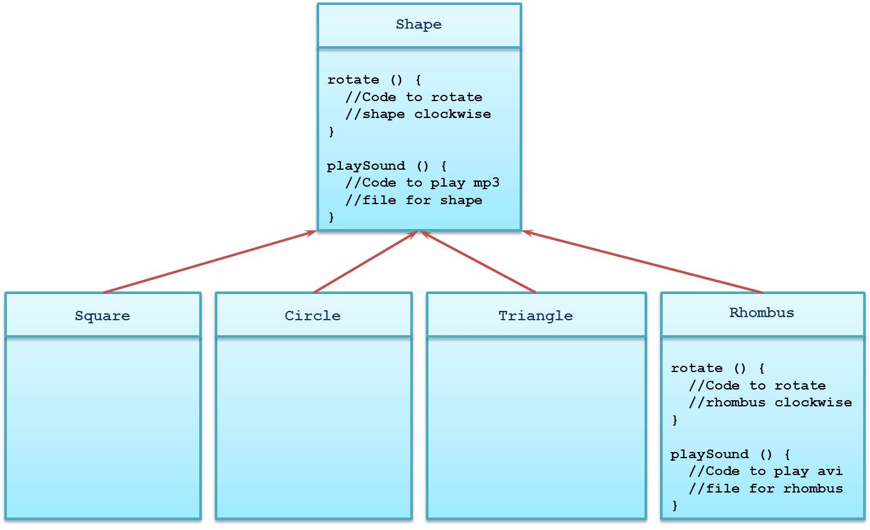

Slide 66
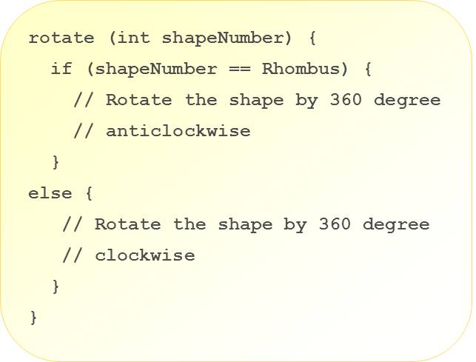

Slide 67
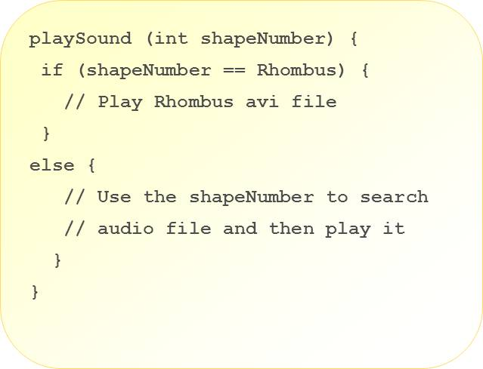

Slide 68
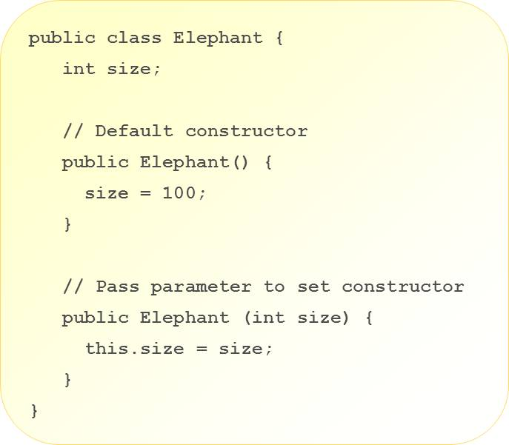

Slide 69
Classes vs. Instances
69
A class is a template for a specific object.
A class defines the attributes and methods that all objects belonging to the class have.
The attributes and methods of a class are called ‘fields’ or ‘members’.
An instance refers to an object that is a member of a particular class. All objects that belong to a class are instances of that class.

Slide 70
Creating and Manipulating Instances of a Class
Instances of a class can be created by using the new keyword. This process is called ‘instantiation’.
The ‘new’ keyword creates the object based on the specified class and returns a reference to the newly created object.
The reference is then received by an appropriate identifier.
<Class Type> <Identifier> = new <Class Type>(<Constructor Parameters>)
Person him = new Person(“John Doe”, 25, ‘M’);
70

Slide 71
Creating and Manipulating Instances of a Class
Fields of object instances can be accessed through their identifiers names.
Access to member fields and methods is done through the use of the ‘dot’ notation.
<reference>.<attribute name>
<reference>.<member method>(<parameters>);
him.setAge(23)
him.getName();
** Refer to the ClassInstanceSample.java and Person.java sample code for examples in all the succeeding sections.
71

Slide 72
Garbage Collection
72
The ‘new’ keyword explicitly allocates resources for an object, but there is no explicit way of telling the system to ‘de-allocate’ an object.
Garbage collection is the process of automatically clearing up the memory being used by objects that will no longer be used by the program.
Invocation of the garbage collector is automatically determined by the Java Virtual Machine, depending on the need to do so.
An application can ‘suggest’ that the system initiate garbage collection using System.gc() or Runtime.getRuntime().gc().

Slide 73
Garbage Collection
73
Garbage collection is used by Java to:
Recover resources (particularly memory) that are much needed by an application.
Avoid dangling pointers.
Ensure program integrity.
Dangling pointers are the occurrence of having variables or references pointing to objects in memory that are not of the appropriate type or value.

Slide 74
Garbage Collection
Pointer /
Reference
him
Person Object
him
Person Object
null
74
Objects are safe from garbage collection if there is at least one reference variable that refers to the object
Person him = new Person();
Objects are eligible for garbage collection when there are no more identifiers that refer to the object
him = null;

Slide 75
Custom Classes
75
A primary aspect of an Object-Oriented programming language is the ability to define customized classes.
A class declaration is (.java) the basic building block of a Java application.
All code is built and attached to a class declaration. There is no code that does not belong to a class.

Slide 76
Custom Classes
76
A Java Class denotes a category of objects, and acts as a blueprint for creating such objects.
Classes declare what package they belong to.
Classes declare what classes to import from other packages.
Fields (also known as variables or attributes) refer to the properties of the class.
Methods (also known as operations) refer to behaviors that the class exhibits.
The source file containing the class declaration must have the same name as the class.

Slide 77
Package Structure and the Class Path
77
Packages are collections of classes.
Packages are used to group classes together, usually based on a certain functionality or relationship.
Classes can be specified to belong to a certain package by using the package keyword:
package <package_name>;
package sef.module4.samples;
The package structure is representative of the directory structure where the class definition is located.

Slide 78
Package Structure and the Class Path
78
The class path is a list of directories and JAR files that contain classes and other resources needed by a Java application to run.
Classes not included in the class path cannot be used by Java (e.g., compiling, runtime, etc.)
The class path can be set many ways, but a common way involves setting the CLASSPATH environment variable in the command prompt.
The class path can contain more than one directory path.
C:> set CLASSPATH=classpath1;classpath2…;
C:> set CLASSPATH=.;C:\SEF;

Slide 79
Importing Classes
79
Importing of classes allows the program to access or use the imported resources.
Imported resources can be a single class or an entire package of classes
import <package_name>; OR import <class-name>;
import java.util.*;
import java.util.Calendar;

Slide 80
Concept of a ‘Constructor' and ‘Finalizer'
Constructors are methods that set the initial state of an object
Constructor name must be the same as the class name
Constructor cannot return a value, not even void
Constructors cannot be inherited
If the class does not explicitly declares a constructor, it will default to a no parameter, do-nothing constructor
public class Cube1
{
private int size;
Cube1(int size)
{
this.size = size;
}
}
80

Slide 81
Concept of a ‘Constructor' and ‘Finalizer'
A finalizer is a special method that is executed to remove the object or resource from memory when it is no longer needed.
The finalize() method is used by the garbage collector to free up resources on memory which are no longer needed.
** Refer to Person.java and FinalizeSample.java sample code.
protected void finalize() throws Throwable
{
try
{
close(); // close open files
}
finally
{
super.finalize();
}
}
81

Slide 82
Attributes and Behavior
82
Variables declared as part of the class represent the data that is contained by instances of this class
The values stored by these variables represent the object’s current ‘attributes’ or ‘state’
Methods declared as part of the class represent the operations that instances of the class can perform
Theses operations are said to be the ‘behavior’ of the object

Slide 83
Member Modifiers
(Default / No Modifier) | A class can be accessed by classes belonging to the same package
Public | A class member can be accessed by any class in any package
Protected | A class member can only be accessed by itself or subclasses
Private | A class member can only be accessed by itself
83
Access Modifiers - describe how a class can be accessed
Non-access Modifiers - describe how a class can be manipulated
abstract
final
strictfp

Slide 84
Member Modifiers
static | Member belonging to a class; shared by all instances of the class
final | Declares a member as a constant and cannot be modified once declared
abstract | Method is declared with no implementation (applied to methods, cannot be combined with other non-access modifiers)
strictfp | Method implements strict floating-point arithmetic (applied to methods)
synchronized | Method is executed by only one thread at a time (applied to blocks of code and methods)
native | Method implementation is written in other language (applied only to methods)
transient | An instance variable is not saved when its object is persisted or serialized (applied only to variables)
volatile | Variable is modified asynchronously by concurrently running threads (applied only to variables)
84

Slide 85
Static Attributes and Methods
85
Static attributes and methods are associated to the class and are shared by all instances of the class
Static attributes and methods are defined by using the keyword static
Static methods can only directly access attributes and call methods that are also static
Static members of a class can be accessed or are reference by the class name
<Class Name>.<static member>
Calendar.getInstance();

Slide 86
Software Abstraction
Abstraction is the process of reducing or simplifying information or a concept in order to retain that which is relevant to the current context
Data is abstracted by high level language constructs, such as:
Numbers
Letters
Higher level data concepts
Functionality is abstracted by presenting interfaces that hide complex logic or algorithms, such as:
Functions
Methods
86

Slide 87
Abstraction and Object-Oriented Programming (OOP)
An OOP language is built around the concept of an object as a software entity
An object is defined as the binding of data and the relevant functions and behavior exposed through a public interface
Objects communicate through the use of public interfaces and do not need to know the inner workings of other objects
Objects are based on classes, which are used to define the attributes and behaviors common to all instances of that class
Classes have hierarchies that define abstractions in their classifications
87

Slide 88
Object-Oriented Programming (OOP)
Object orientation is a powerful means of expressing a problem domain and its solution, but it is still subject to limitations and pitfalls.
The mindset of an OO designer must be focused on creating small, simple re-usable components that can be combined to create more complex systems.
88

Slide 89
Design by Interface
An OO designer needs to separate the concerns of behavior from the concerns of implementation.
It is a good principle to first define behavior by defining the interfaces that will be implemented by a class of objects.
Defining interfaces first imposes a mind-set of determining how the different objects communicate with each other.
Client objects should only be aware of the interfaces that are implemented by the objects they are dependent on.
The exposed interfaces should present parameters and return types that are not dependent on the implementation details.
89

Slide 90
High Cohesion
It is important to remember that an object binds relevant data and behavior together.
A common pitfall in OO is designing an object to be able to do too many, possibly unrelated or loosely related things (low cohesion).
An object exhibits high cohesion if all of its behavior is strongly related within the context of the object’s overall functionality.
The functionality of the object itself must be designed with a very focused and specific goal.
90

Slide 91
Loose Coupling
Refers to objects that do not require knowledge of the specific implementations it’s dependent on in order to function
Is a natural result of high cohesion and designing by interfaces
An object is loosely coupled with another object if a change in one object doesn’t necessitate a change in the other
91

Slide 92
Code by Interface
Implementation 1
Client Application
public execute(Details){
//actual implementation
….
}
Interface conn =
factory.retrieve();
conn.execute(details);
implements
Interface
Mock Implementation
public execute(Details)
Public execute(Details){
//fake data for testing
…
}
references
implements
Interface Implementation 2
public execute(Details){
//actual implementation
….
}
implements
92

Slide 93
Design Patterns
Design patterns in Object-Oriented Programming are re-usable solutions to a commonly occurring design problem.
Can be used to improve the development process by providing tested design solutions to recurring design problems.
Can be used to overcome language limitations when implementing certain designs.
Design patterns adhere to the previously discussed principles of high cohesion, loose coupling.
93

Slide 94
Singletons
A singleton pattern
Is a creational pattern that restricts the creation of instances of a class to just 1 instance.
Is used in situations where it might be more efficient to just have a single instance of the object rather several instances of the same object whose states need to be coordinated.
Example:
Refer to Singleton.java and SingletonSample.java for non-threadsafe implementation.
Refer to SingletonRecommended.java for recommended implementation of Singleton.
94

Slide 95
Adapter
Adapter pattern:
Is used to solve the problem of two objects with incompatible interfaces that need to work together.
Is called a ‘wrapper’ as it takes an object and wraps it with an interface that is compatible with the client objects requirements.
Allows the client object to be decoupled from the adapted object. Only the adapter will have visibility on both objects.
Example:
Refer to AdapterSample, AdapterClient.java, AdapterInterface.java, Worker.java and the two Worker implementation classes
95

Slide 96
Strategy Pattern
The strategy pattern:
Is a common pattern whose main principle forms the basis of many other design patterns.
Encapsulates variations in an object’s behavior by delegating it to another object.
An object can dynamically change its behavior without having to alter its code by changing its delegate object.
Example:
Refer to StartegySample.java in module 7 and AdapterClient.java in module 5.
96

Slide 97
Factory Methods
Use of the ‘new’ keyword directly requires that the client object know the actual class of whatever is being instantiated
Factory methods
Can be used to hide this detail by delegating the responsibility of creating objects to a method
Can control how instances are being created based on the rules of the factory method
Example:
Refer to FactorySample.java and WorkerFactory.java for sample code.
97
Notes:
Factory methods can be designed in such a way that it can control how instances are created. For example, if a factory method is used to create a certain type of immutable object with a certain set of attributes, the method can maintain a list of previously created objects to see if it has been created before. It can then return a reference to this object instead of having to create a duplicate of this object. This represents savings in both heap memory and cpu processing time.

